Slide 1
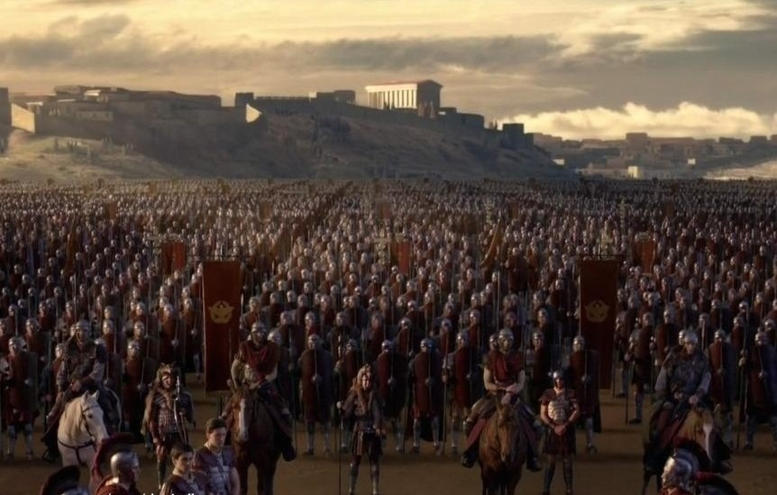
Death and Burial
In the Roman Legions
By: Eric Noah

Slide 2
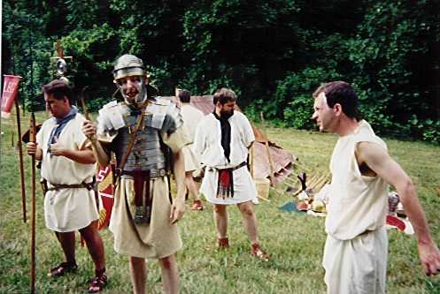
The Collegia

Slide 3
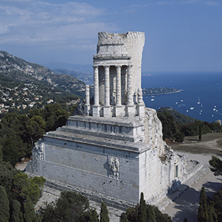
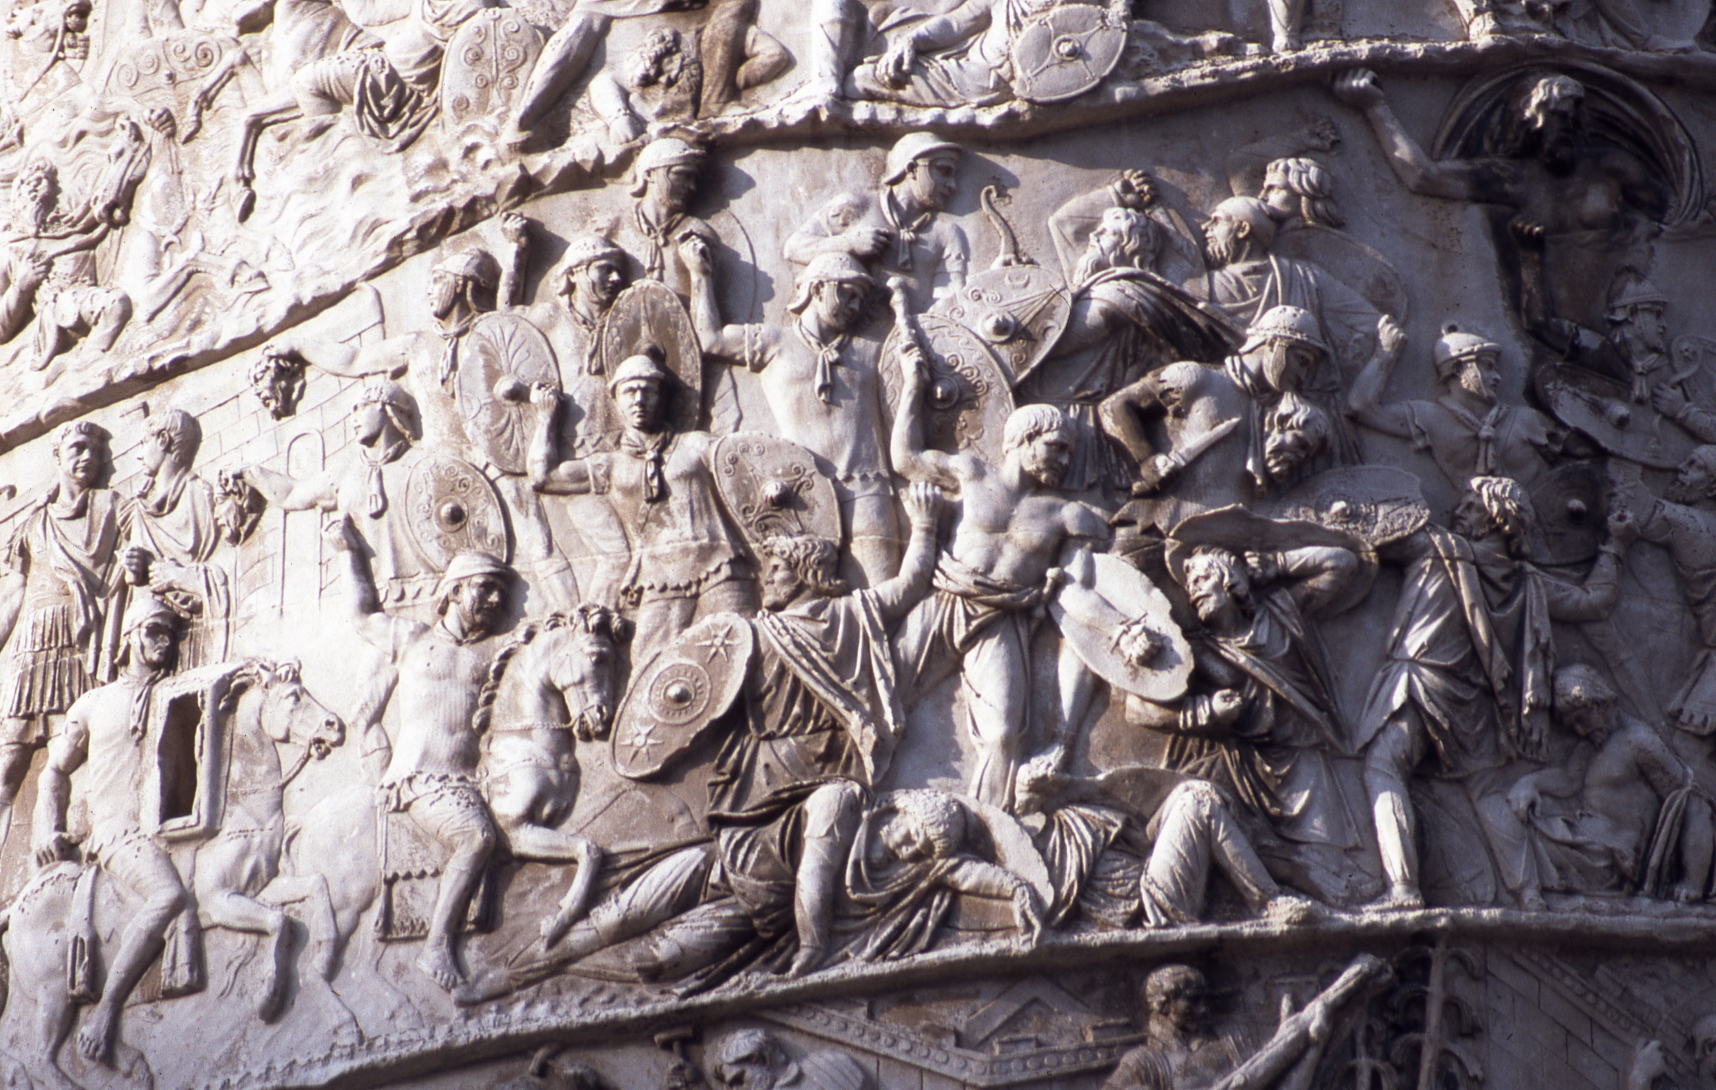
Honor to Soldiers in Memorium
Trophy of Augustus
Trajan's Column

Slide 4
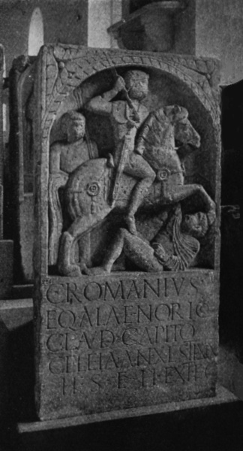
Commemoration of the Dead

Slide 5
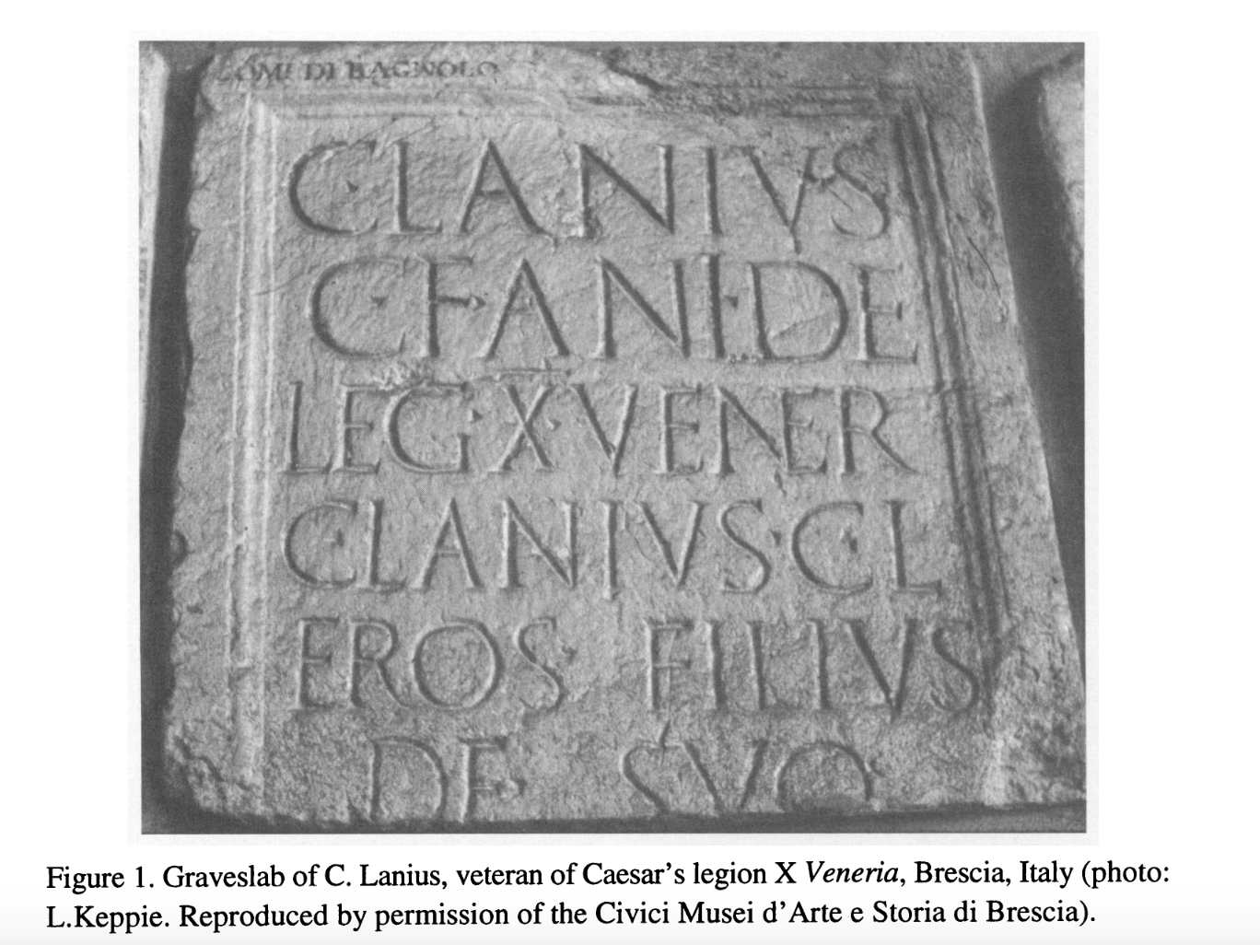
Commemoration of the Dead

Slide 6
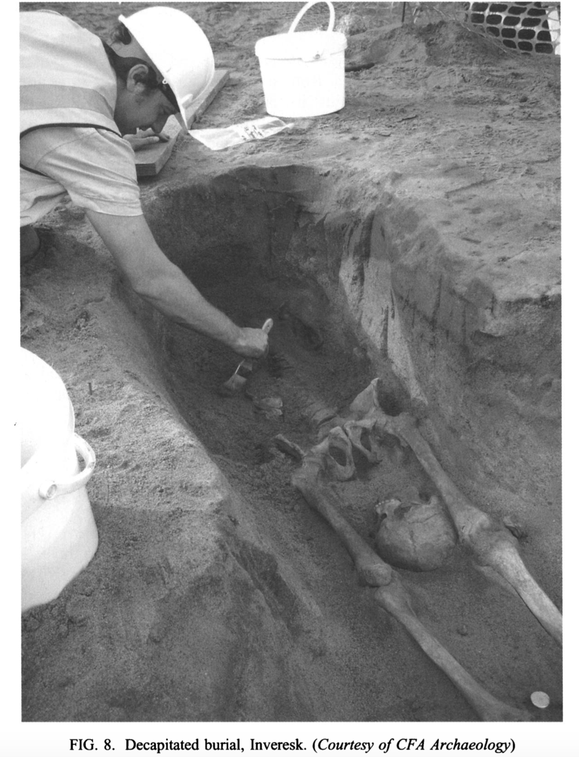
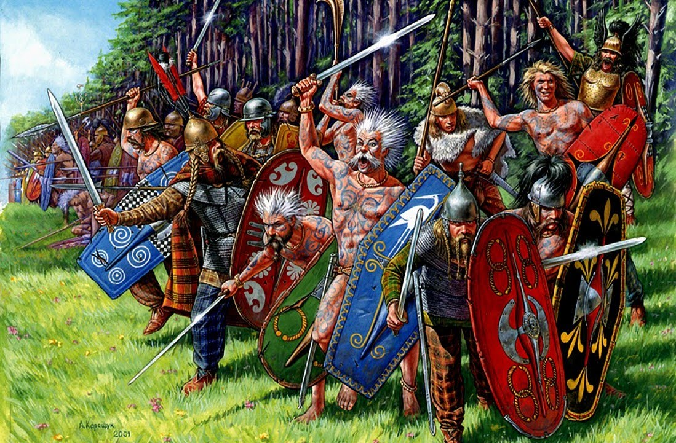
Burials Abroad (Britian)
Devient Burials in Britian

Slide 7
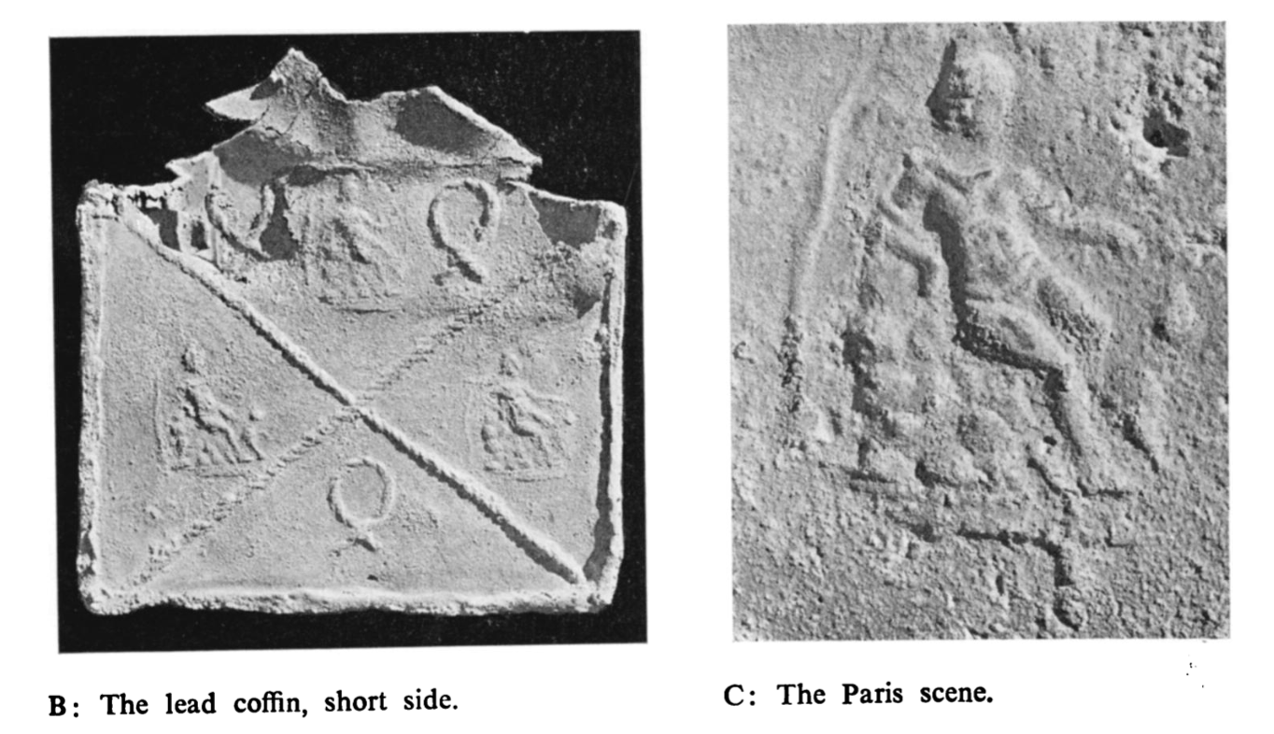
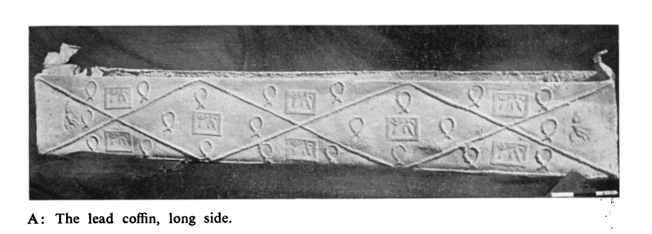
Burials Abroad (Asia)
Legionaries buried In Judea w/ Family

Slide 8
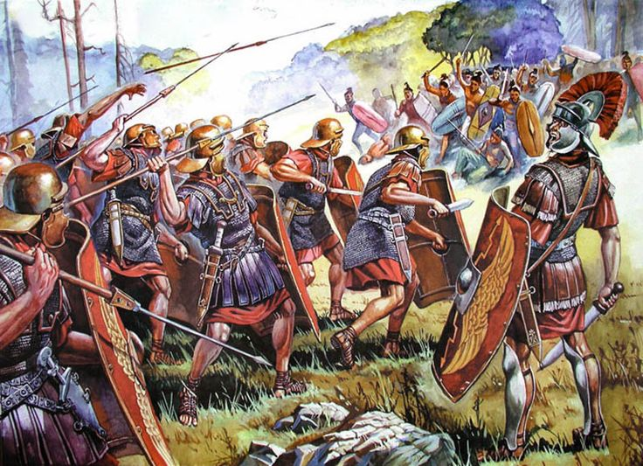
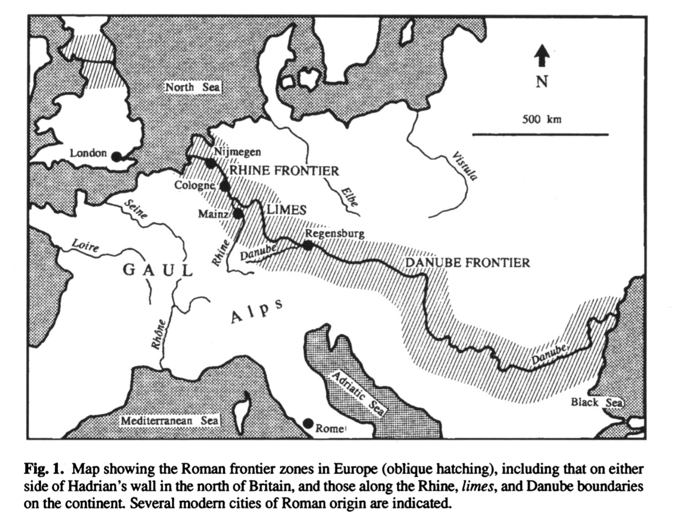
Burials Abroad (Danube Frontier)
Legionaries found with weapons

Slide 9
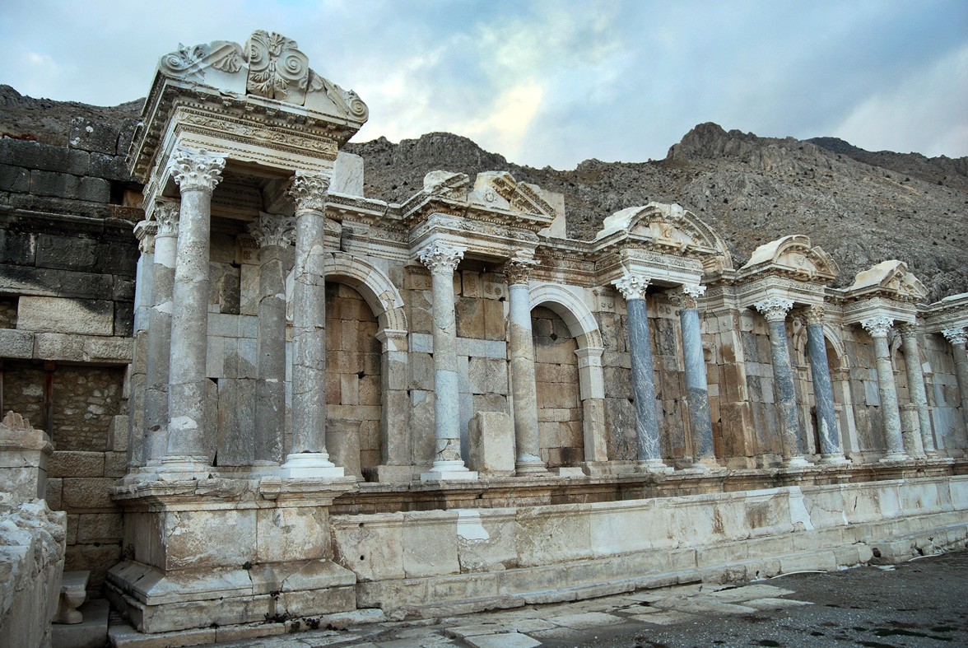
Placement of Monuments

Slide 10
Bibliography
Textual Sources
Hope, Valerie. "Trophies and tombstones: Commemorating the Roman soldier." World Archaeology 35, no. 1 (2003): 79-97. doi:10.1080/0043824032000078090.
Chapman, Evan M., Fraser Hunter, Pete Wilson, Paul Booth, Sally Worrell, John Pearce, and R.S. O. Tomlin. "Roman Britain in 2011." Britannia 43 (2012): 271-422.
Keppie, Lawrence. "‘Having Been A Soldier’ The Commemoration Of Military Service On Funerary Monuments Of The Early Roman Empire1." Bulletin of the Institute of Classical Studies 46, no. S81 (2003): 31-53. doi:10.1111/j.2041-5370.2003.tb01976.x.
Ginsburg, Michael. "Roman Military Clubs and Their Social Functions." Transactions and Proceedings of the American Philological Association 71 (1940): 149. doi:10.2307/283119.
Gath, Joseph, and L. Y. Rahmani. "A Roman Tomb at Manaḥat, Jerusalem." Israel Exploration Journal 27, no. 4 (1977): 209-14.
Wells, Peter S. "Creating an Imperial Frontier: Archaeology of the Formation of Rome?s Danube Borderland." Journal of Archaeological Research 13, no. 1 (2005): 49-88. doi:10.1007/s10814-005-0810-y.
Visual Sources
http://www.trophee-auguste.fr/var/cmn_inter/storage/images/mediatheque/mediatheque-commune/images/trophee-d-auguste-a-la-turbie-carre/1252548-1-fre-FR/Trophee-d-Auguste-a-La-Turbie-carre.jpg
http://www.novaroma.org/via_romana/reenactments/rd_soldiers03.jpg
https://arts.st-andrews.ac.uk/trajans-column/uploads/TC-024.27-50.jpg
https://www.gutenberg.org/files/51769/51769-h/images/i_001.jpg
https://i.ytimg.com/vi/fPv0UuHoQe8/maxresdefault.jpg
http://blog.biletbayi.com/wp-content/uploads/2017/08/sagalassos-burdur-tarihi.jpg
https://i.pinimg.com/736x/5f/15/f1/5f15f1cbe77e4a76b3f06bdd33e17f25--roman-legion-roman-soldiers.jpg
http://www.romeacrosseurope.com/wp-content/uploads/2015/03/legionari-4.jpg

Slide 11
End with Glory
https://www.youtube.com/watch?v=pgGYu3lzmpg

